Slide 1
Grouping and Scheduling
Problem
- Genetic Algorithm -

Slide 2
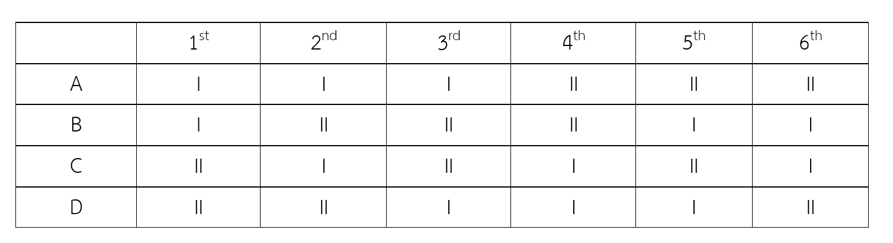
Motivation
Create Planner
Member = 4 (A, B, C, D)
Activity = 2 (I, II)
Man Day = 6
Constraint!

Slide 3
Methodology
Genetic Algorithm
Mutation
Cross Over
Selection

Slide 4
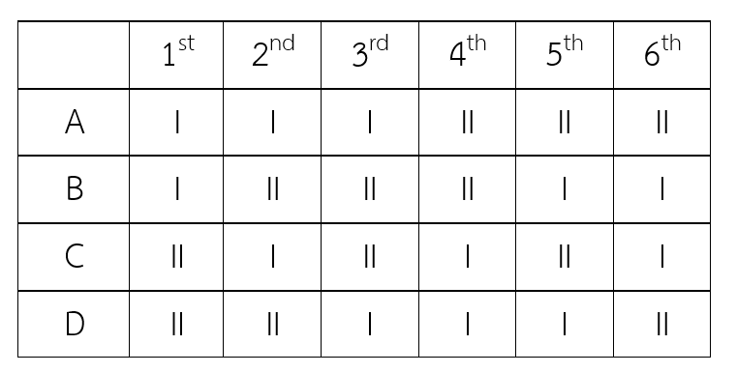
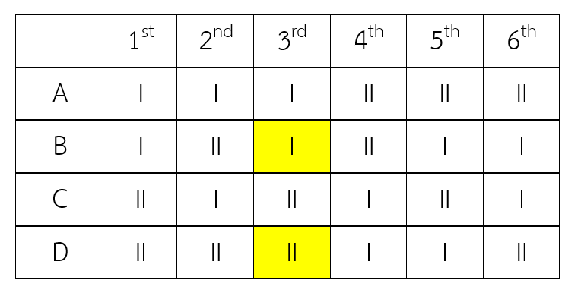
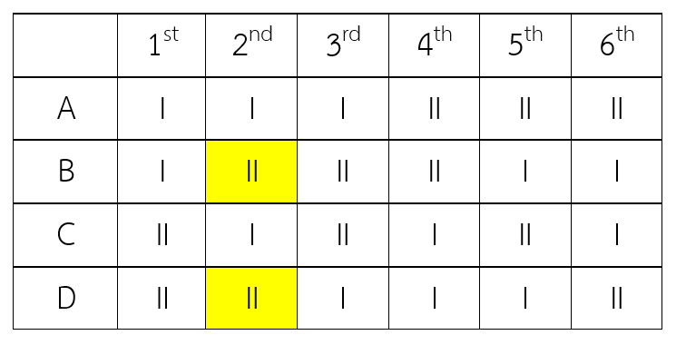
Mutation

Slide 5
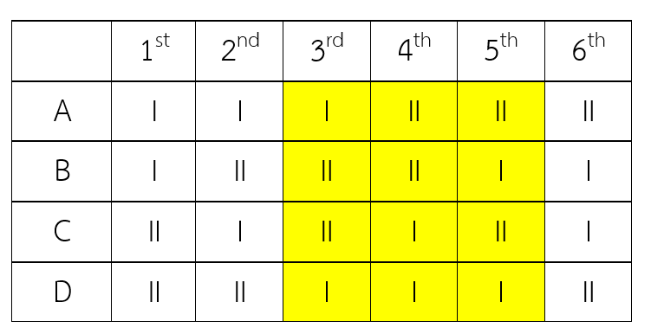
Cross Over

Slide 6
Selection
fitnessValue = 2*checkAct + 1*checkMeet

Slide 7
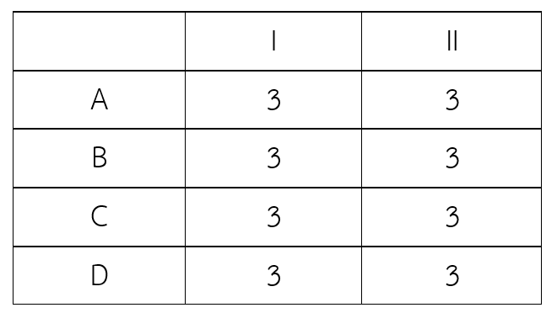
CheckAct
BestValue = manDay/nActivity

Slide 8
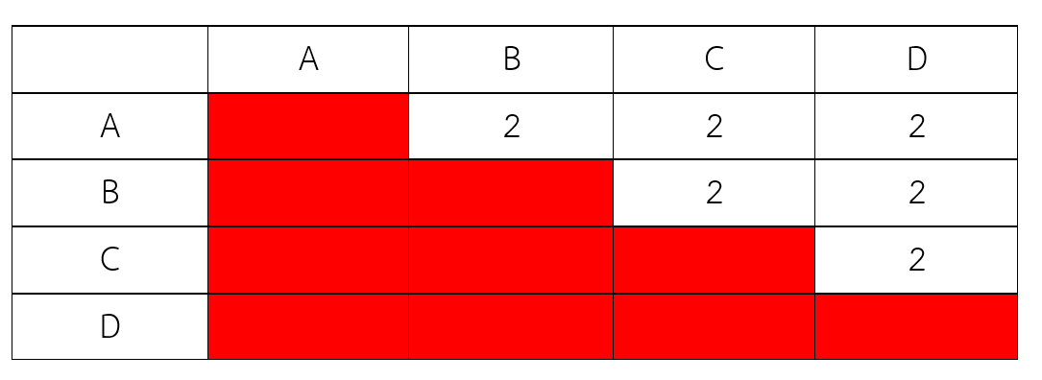
CheckMeet
nCell = nMember*(nMember - 1)/2
nMeeting = combi((member/act), 2)*nActivity*manDay
BestValue = nMeeting/nCell

Slide 9
Demo

